Slide 1
RL algorithms analysis

Slide 3
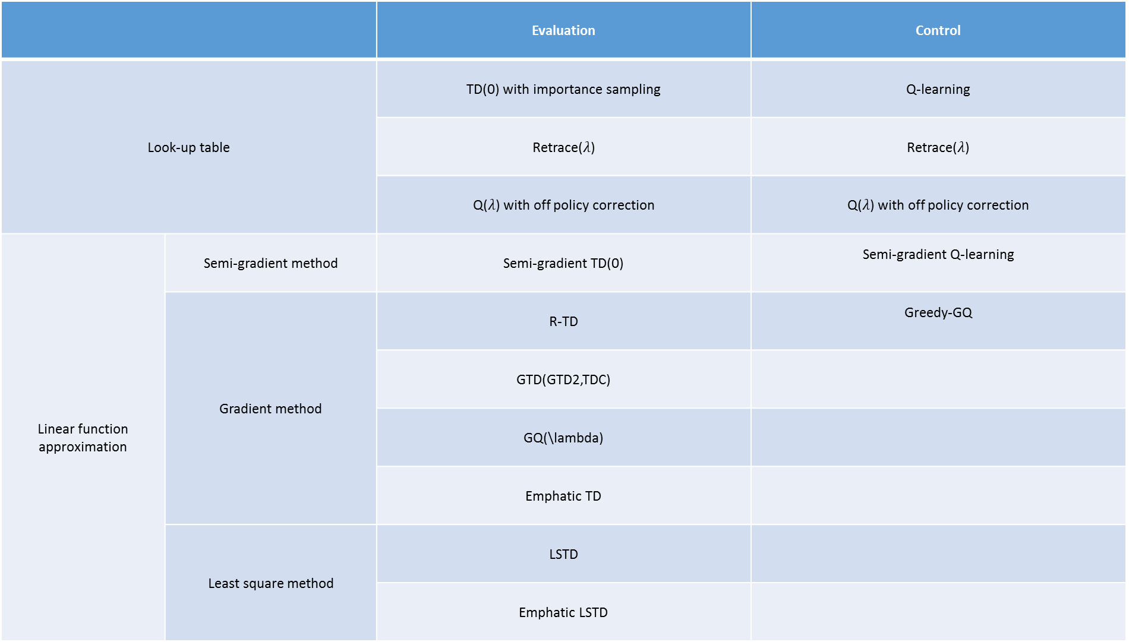
 |  | Evaluation | Control
Look-up table |  | TD(0) with importance sampling | Q-learning
 |  | Retrace($λ$) | Retrace($λ$)
 |  | Q($λ$) with off policy correction | Q($λ$) with off policy correction
Linear function approximation | Semi-gradient method | Semi-gradient TD(0) | Semi-gradient Q-learning
 | Gradient method | R-TD | Greedy-GQ
 |  | GTD(GTD2,TDC)
 |  | GQ(\lambda)
 |  | Emphatic TD
 | Least square method | LSTD
 |  | Emphatic LSTD

Slide 4
Evaluation problem
Look up table setting

Slide 5
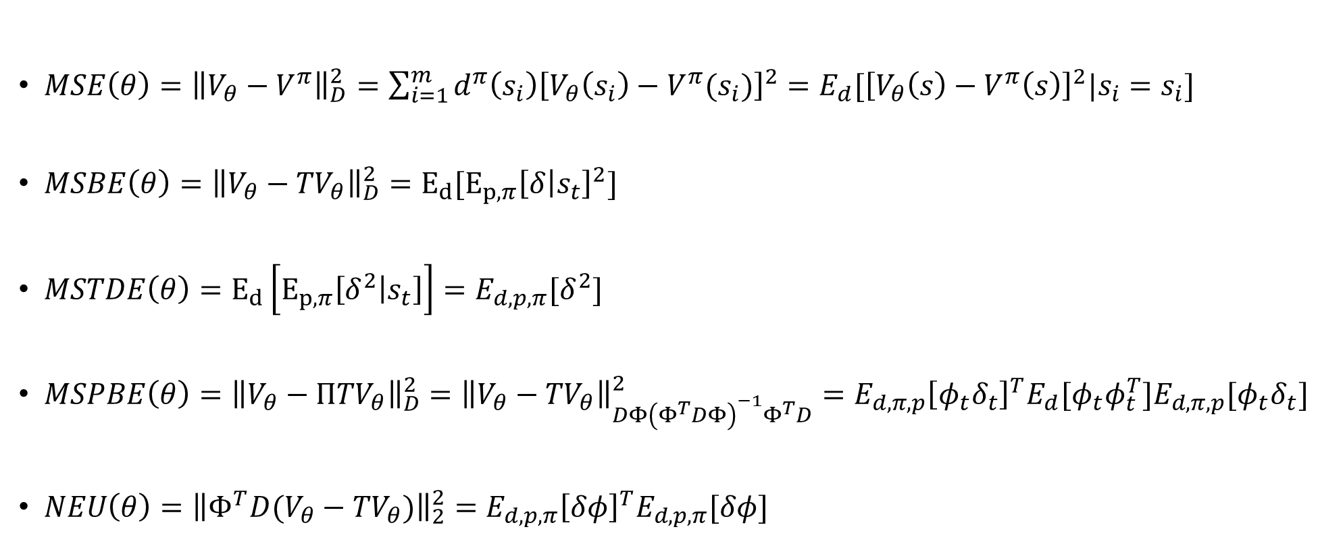
$MSE\left(θ\right)={\left\|V_{θ}−V^{π}\right\|}_{D}^{2}=\sum_{i=1}^{m}{d^{π}\left(s_{i}\right){\left[V_{θ}\left(s_{i}\right)−V^{π}(s_{i})\right]}^{2}=E_{d}[{\left[V_{θ}\left(s\right)−V^{π}\left(s\right)\right]}^{2}|s_{i}=s_{i}]}$
$MSBE\left(θ\right)={\left\|V_{θ}−{TV}_{θ}\right\|}_{D}^{2}=E_{d}[E_{p,π}{\left[δ | s_{t}\right]}^{2}]$
$MSTDE\left(θ\right)=E_{d}\left[E_{p,π}\left[δ^{2} | s_{t}\right]\right]=E_{d,p,π}[δ^{2}]$
$MSPBE\left(θ\right)={\left\|V_{θ}−{ΠTV}_{θ}\right\|}_{D}^{2}={\left\|V_{θ}−{TV}_{θ}\right\|}_{DΦ{\left(Φ^{T}DΦ\right)}^{−1}Φ^{T}D}^{2}=E_{d,π,p}{\left[φ_{t}δ_{t}\right]}^{T}E_{d}[φ_{t}φ_{t}^{T}]E_{d,π,p}[φ_{t}δ_{t}]$
$NEU\left(θ\right)={\left\|{Φ^{T}D(V}_{θ}−{TV}_{θ})\right\|}_{2}^{2}=E_{d,p,π}{\left[δφ\right]}^{T}E_{d,p,π}[δφ]$
Notes:
$$={\left[V_{θ}−V^{π}\right]}^{T}D\left[V_{θ}−V^{π}\right]$$

Slide 6
[1] H. Yu JANEYHZYU, “On Convergence of Emphatic Temporal-Difference Learning *,” 2015.
[1] R. S. Sutton, A. R. Mahmood, and M. White, “An Emphatic Approach to the Problem of Off-policy Temporal-Difference Learning,” J. Mach. Learn. Res., vol. 17, pp. 1–29, 2016.
[1] A. Hallak, A. Tamar, R. Munos, and S. Mannor, “Generalized Emphatic Temporal Difference Learning: Bias-Variance Analysis,” in Proceedings of the 30th Conference on Artificial Intelligence (AAAI 2016), 2016, no. Yu, pp. 1–17.
[1] A. Harutyunyan, M. G. Bellemare, T. Stepleton, and R. Munos, “Q(??) with off-policy corrections,” Lect. Notes Comput. Sci. (including Subser. Lect. Notes Artif. Intell. Lect. Notes Bioinformatics), vol. 9925 LNAI, pp. 305–320, 2016.
[1] R. Munos, T. Stepleton, A. Harutyunyan, and M. Bellemare, “Safe and Efficient Off-Policy Reinforcement Learning,” Nips, pp. 1046–1054, 2016.
[1] B. Liu, J. Liu, M. Ghavamzadeh, S. Mahadevan, and M. Petrik, “Finite-Sample Analysis of Proximal Gradient TD Algorithms,” Uai, 2015.
[1] I. Osband and B. Van Roy, “On Lower Bounds for Regret in Reinforcement Learning,” pp. 1–10, 2016.
[1] M. Tagorti and B. Scherrer, “On the Rate of Convergence and Error Bounds for LSTD (λ).,” ICML, 2015.
[1] A. R. Mahmood, H. van Hasselt, and R. S. Sutton, “Weighted importance sampling for off-policy learning with linear function approximation,” Proc. Adv. Neural Inf. Process. Syst., pp. 1–12, 2014.

Slide 7
On the rate of convergence and error bounds for LSTD($λ$)

Slide 8
On converge of emphatic temporal difference learning

